Slide 1

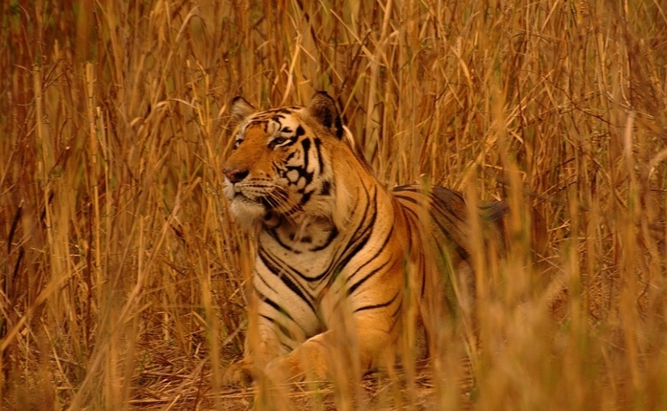
Adaption of XCS to Multi-Learner Predator/Prey Scenarios
Clemens Lode, Urban Richter, Hartmut Schmeck
Karlsruhe Institute of Technology (Germany)
Institute AIFB
July, GECCO 2010
http://www.flickr.com/photos/shreeram

Slide 2
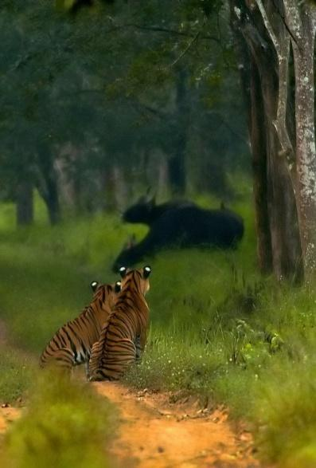
Outline
Learning Classifier Systems
XCS in Predator/Prey Scenarios
Adapting the Reward Function
Experimental Results
http://www.flickr.com/photos/yathin

Slide 3
Environment
Input: 0011
Population [P]
C A ρ ε F
#011 : 01 43 .01 99
11## : 00 32 .13 9
#0## : 11 14 .05 52
001# : 01 27 .24 3
#0#1 : 11 18 .02 92
1#01 : 10 24 .17 15
…
Action: 01
Reward
Prediction array
Action set [A]
Match set [M]
Action
selection
00 01 10 11
nil 42.5 nil 16.6
#011 : 01 43 .01 99
001# : 01 27 .24 3
#011 : 01 43 .01 99
#0## : 11 14 .05 52
001# : 01 27 .24 3
#0#1 : 11 18 .02 92
Max
Discount
+
Delay = 1
P
Previous
action set [A]₋₁
Genetic
operators
Covering
Update ρ ε F
Wilson, S. W. Koza, J. R. & others (ed.) Generalization in the XCS Classifier System Genetic Programming 1998: Proceedings of the Third Annual Conference, 1998, 665-674

Slide 4
Learning Classifier Systems
Standard (Multi-Step) Problem:
Maze6
Goal:
Find the shortest path to from a random position to food
T: Tree
F: Food

Slide 5
Learning Classifier Systems
Problem:
Limited sensors, no global knowledge
Partially observable Markov decision process
Solution:
Iterations, back-propagation of reward
T: Tree
F: Food

Slide 6
Learning Classifier Systems
Problem:
Limited sensors, no global knowledge
Partially observable Markov decision process
Solution:
Iterations, back-propagation of reward
Aliasing positions:
Handle by using memory
T: Tree
F: Food

Slide 7
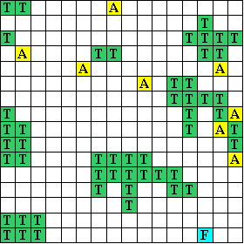
Predator/Prey Scenarios
Many aliasing positions
Other agents present
Dynamic world
food and other agents move
Limited sensors
ca. 5 cells range
T: Trees
F: Food
A: Agent

Slide 8
Predator/Prey Scenarios
Terminology:
Obstacles, prey, predator
Goal: Try to stay near the prey
Global observation task
Runs continuously
Maximize average quality
T: Trees/Obstacles
F: Food/Prey
A: Agent/Predator

Slide 9
Classification of Predator/Prey Scenarios
Access to local information only
Open areas with some obstacles
Internal state unknown to others
No standard MDP
Limited sensors (1, 3)
Aliasing positions (2)

Slide 10
Classification of Predator/Prey Scenarios
Access to local information only
Open areas with some obstacles
Internal state unknown to others
Dynamic scenario
No standard MDP
Limited sensors (1, 3)
Aliasing positions (2)
No POMDP
Non-static scenario (4)

Slide 11
Classification of Predator/Prey Scenarios
Access to local information only
Open areas with some obstacles
Internal state unknown to others
Dynamic scenario
Predators share global observation task
Runs continuously
No standard MDP
Limited sensors (1, 3)
Aliasing positions (2)
No POMDP
Non-static scenario (4)
XCS has to be adapted
No “final” reward (5), no iterations (6)

Slide 12
Adaption of the Standard XCS Reward Function
Standard implementation:
Reward:
Prey is in a neighboring cell
Adapted implementation
Reward:
Prey is in observation range
“XCS obs”
Prey is in sight range
“XCS sight”

Slide 13
Adaption of the Standard XCS Reward Function
Standard implementation:
Reward:
Prey is in a neighboring cell
Reward action:
Assign reward
Restart scenario
Explore/exploit phase
Adapted implementation
Reward:
Prey is in observation range
“XCS obs”
Prey is in sight range
“XCS sight”
Reward action:
Assign reward
Continue scenario
Always use exploit phase

Slide 14
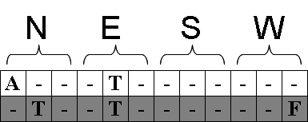
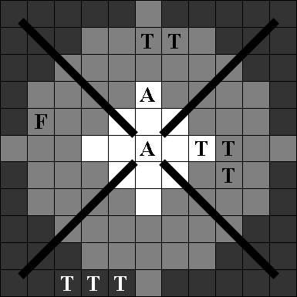
Sensors
One sensor array for each direction

Slide 15
Sensors
Sensors can sense either far or near (observation range / sight range)
One sensor array for each direction

Slide 16
Sensors
Sensors can sense either far or near (observation range / sight range)
Sensors can distinguish between predators, prey, and obstacles
One sensor array for each direction

Slide 17
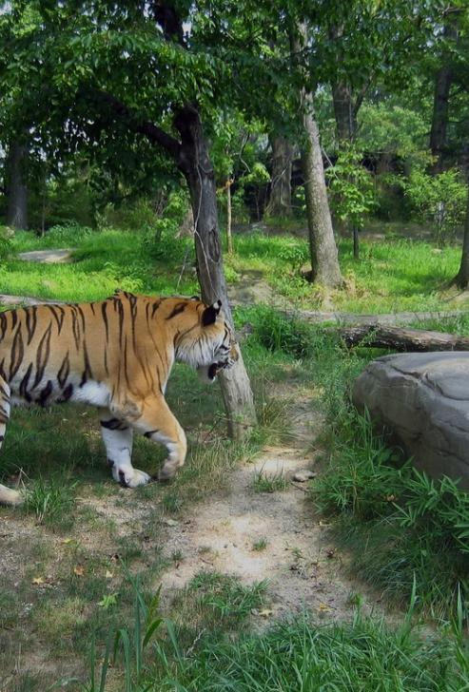
Testing Methodology
Behavior
1 Prey
“Obstacle-evading prey”
“Predator-evading prey”
“Blinded Prey”
Speed 2 cells / step
8 Predators
Speed 1 cell / step
Standard XCS parameter settings
http://www.flickr.com/photos/james_crowley

Slide 18
Testing Methodology
2,000,000 steps
Reset of XCS every 20,000 steps (=“experiment”)
Reset of scenario (new random positions) every 2,000 steps

Slide 19
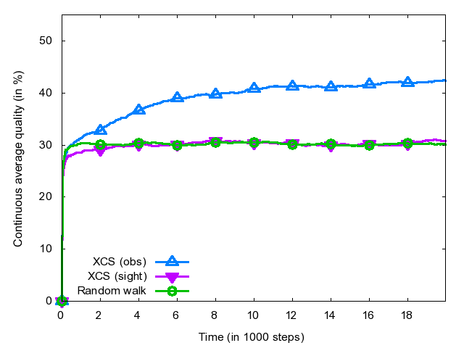
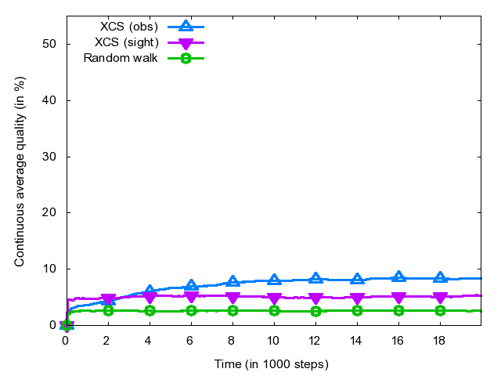
XCS Experimental Results “Pillar Scenario”
XCS (obs) shows some learning
Obstacle-evading prey
Predator-evading prey

Slide 20
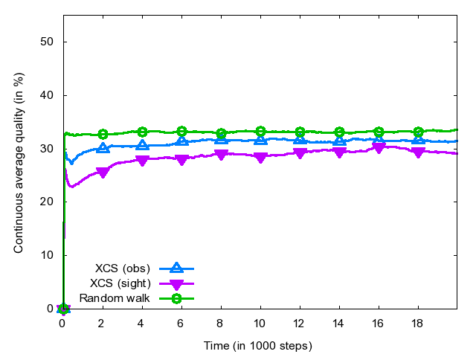
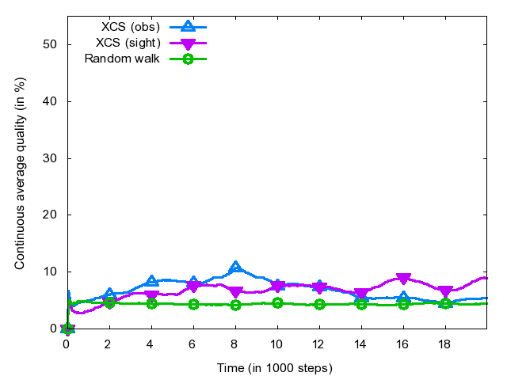
XCS Experimental Results “Random Scenario”
XCS shows very little learning
Obstacle-evading prey
Predator-evading prey

Slide 21
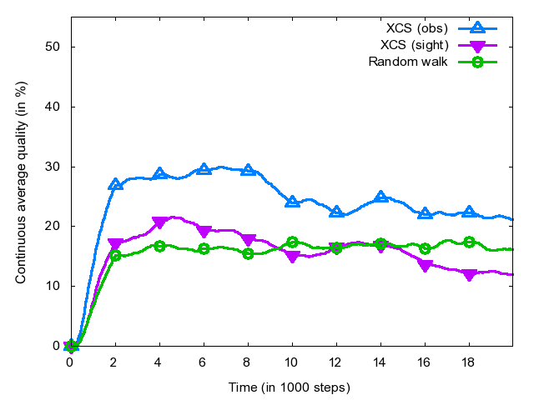
XCS Experimental Results “Difficult Scenario”
XCS shows significant learning
But also unlearning after 8,000 steps
“Difficult Scenario” is a maze-like scenario, this result was expected
Blinded prey

Slide 22
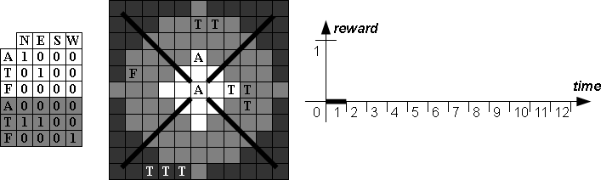
Reward Events “eventXCS”
Move West

Slide 23
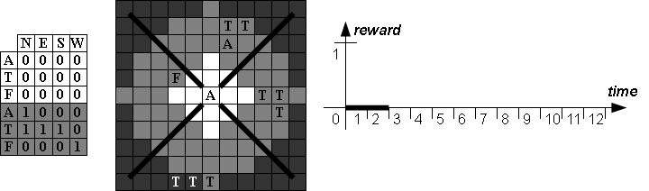
Reward Events “eventXCS”
Move West

Slide 24
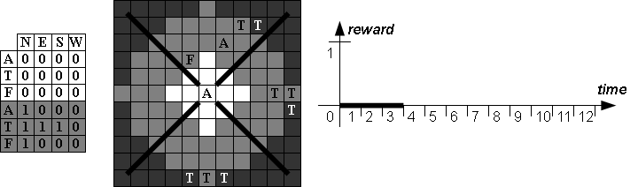
Reward Events “eventXCS”
Move North

Slide 25
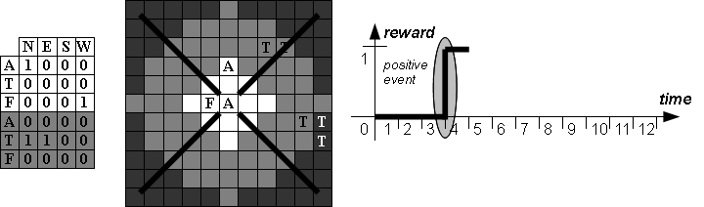
Reward Events “eventXCS”
Move West

Slide 26
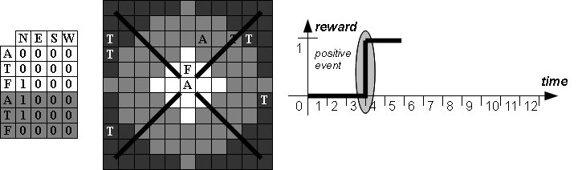
Reward Events “eventXCS”
Move North

Slide 27

Reward Events “eventXCS”
Move North

Slide 28
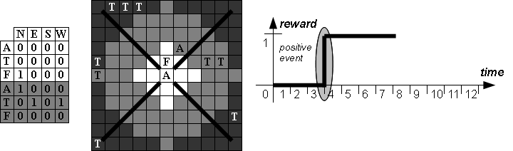
Reward Events “eventXCS”
Move West

Slide 29
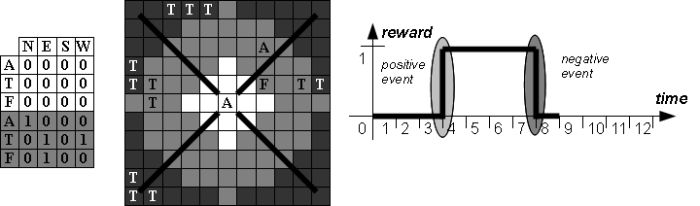
Reward Events “eventXCS”

Slide 30
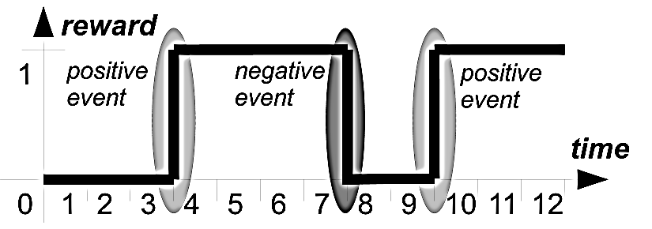
Reward Distribution “eventXCS”
Analyze succession of positive and negative events

Slide 31
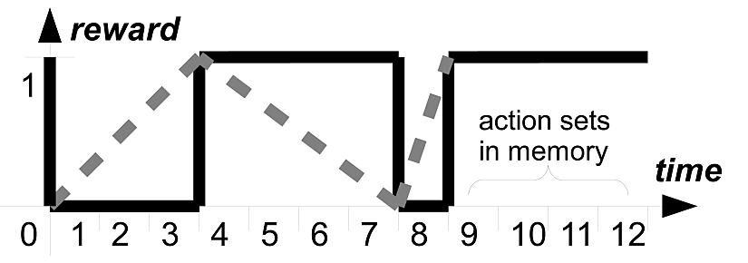
Reward Distribution “eventXCS”
Analyze succession of positive and negative events
Distribute the reward as soon as possible (i.e. at each event)
Idea:
Action sets close to an event probably contributed more

Slide 32
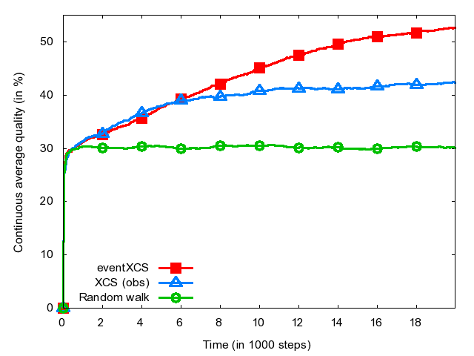
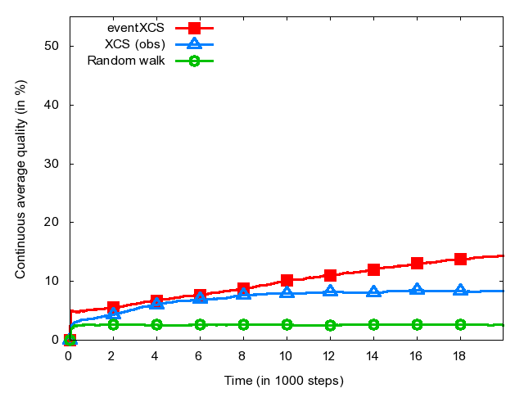
Experimental Results “Pillar Scenario”
eventXCS clearly outperforms XCS
Obstacle-evading prey
Predator-evading prey

Slide 33
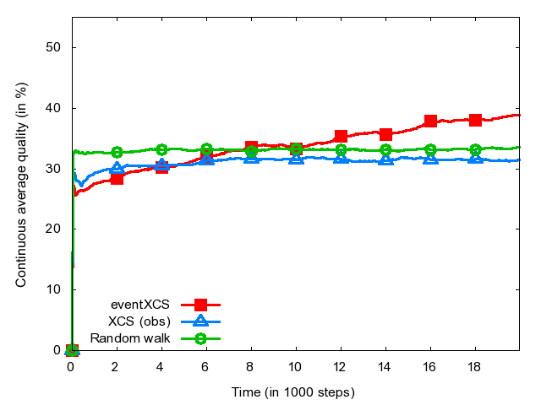
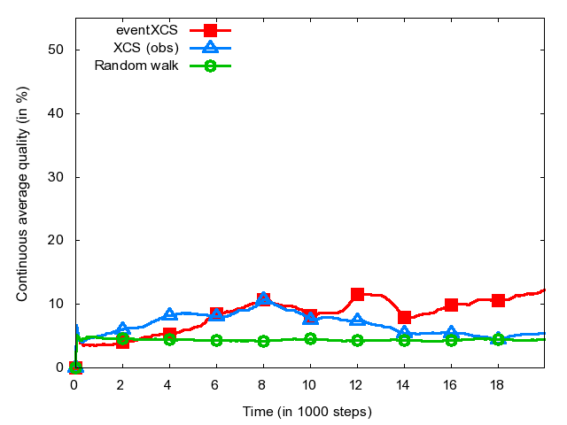
Experimental Results “Random Scenario”
eventXCS shows slow but steady
learning with an obstacle-evading prey
Obstacle-evading prey
Predator-evading prey

Slide 34
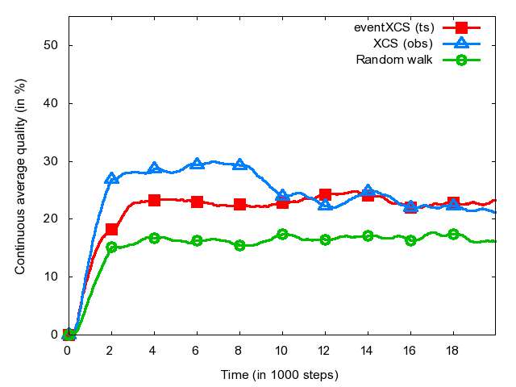
Experimental Results “Difficult Scenario”
eventXCS fails in this scenario (not displayed, fitness = ~0)
Using “tournament selection” shows acceptable results with no sign of unlearning
Blinded prey

Slide 35
Conclusion
Predator/Prey scenarios are NOMDP
XCS can learn (with minimal adaptions) in some P/P scenarios
Using event handling and reward distribution (eventXCS) much better learning can be observed
But: Might need some improvement in difficult scenarios

Slide 36
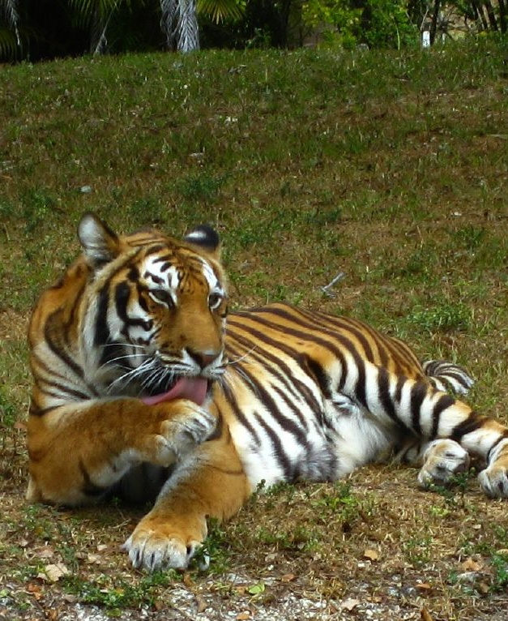
Conclusion
Predator/Prey scenarios are NOMDP
XCS can learn (with minimal adaptions) in some P/P scenarios
Using event handling and reward distribution (eventXCS) much better learning can be observed
But: Might need some improvement in difficult scenarios
Thank you for your attention!
Questions?

Slide 37
Contact Information
Clemens Lode
clemens@lode.de

Slide 38
Backup slides

Slide 39
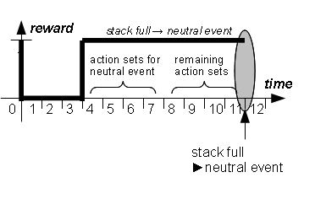
Neutral Events
Neutral Event
No positive or negative event for a number of steps
Half of the action sets is discarded and receives reward
Idea:
Good actions are rewarded earlier
Preventing of dead ends
39

Slide 40
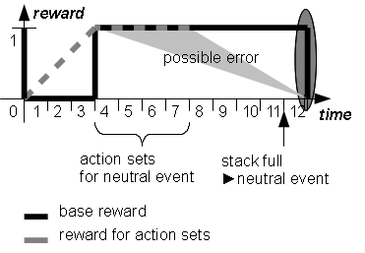
Neutral Events
Neutral Event
No positive or negative event for a number of steps
Half of the action sets is discarded and receives reward
Idea:
Good actions are rewarded earlier
Preventing of dead ends
Problem:
Error possibility high if directly followed by an event.
40

Slide 41
Neutral Events
Tests have shown that a stack size of 8 is generally good for all three scenarios
“Pillar Scenario”
“Random Scenario”
“Difficult Scenario”

Slide 42
Learning Rate β
Pillar Scenario
Obstacle-evading prey
Low learning rate (0.05) good
eventXCS very stable

Slide 43
Learning Rate β
Pillar Scenario, Predator-evading prey
Random Scenario, Obstacle evading prey
Random Scenario, Predator evading

Slide 44
Learning Rate β
Difficult Scenario
High learning rates show an advantage because of long distance to the prey

